Slide 1
Welcome to our presentation
On
Sequence alignment
Title: multiple sequence alignment
Md. Harun-or-roshid-(kawsar)
m.sc-2018
Roll no: 14034826
Department of statistics, ru

Slide 2
outlines
Definition of msa
Purposes of msa
Types of msa
Construction method
Neighbor-joining method

Slide 3
Multiple Sequence Alignment
Let S1, S2, · · · , Sk be k sequences over an alphabet X. We use |Si| to denote the length of Si. An alignment of S1, S2, · · · , Sk is given by a k × n matrix A, where n |Si| for every i k, such that
Row i contains characters of Si in order, interspersed with n−|Si| spaces, and
Each column contains at least one letter from X.

Slide 4
Example:
The following is an alignment of 4 sequences
M Q P I L L - G
M L R - L L - -
M K - I L L L -
M P P V L L I -

Slide 5
PURPOSE OF MSA
In order to characterize protein families, identify shared regions of homology in a multiple sequence alignment
Determination of the consensus sequence of several aligned sequences.
Consensus sequences can help to develop a sequence “finger print” which allows the identification of members of distantly related protein family (motifs)
MSA can help us to reveal biological factsabout proteins, like analysis of the secondary/tertiary structure

Slide 6
Scoring a multiple sequence alignment
The score of a multiple alignment is defined as the sum of scores of columns. Various scoring schemes have been proposed to score a column.
1. Sum of Pairs (SP): The SP score of a column in the alignment is the sum of the scores of all pairs of characters in the column. For example, in the above example, the score SP(P,R,−, P) of the 3rd column is
s(P,R) + s(P,−) + s(P, P) + s(R,−) + s(R, P) + s(−, P)
where s(a, b) is the score of the pair a and b(including spaces) and s(−,−) = 0.

Slide 7
Scoring a multiple sequence alignment
2. Consensus score: The consensus of a multiple alignment is a sequence of the most common characters in each column of the alignment. For example,
M Q P I L - L
M L R - L - L
M K - I L L L
M P P V L L I
consensus M Q P I L L L

Slide 8
TYPES OF MSA
Dynamic programming approach: Computes an optimal alignment for a given score function. Because of its high running time , it is not typically used in practice.
Progressive method: This approach repeatedly aligns two sequences, two alignments, or a sequence with an alignment.
Iterative method: Works similarly to progressive methods but repeatedly realigns the initial sequences as well as adding new sequences to the growing MSA.

Slide 9
PROGRESSIVE ALIGNMENT
The most widely used approach
Builds up a final MSA by combining pairwisealignments beginning with the most similar pair and progressing to the most distantly related
Progressive alignment methods require two stages:
‐Afirst stage in which the relationships between the sequences are represented as a tree, called a guidetree
‐Second step in which the MSA is built by addingthe sequences sequentially to the growing MSA according to the guide tree

Slide 10
PROGRESSIVE ALIGNMENT
For simple,
“Initially, two closely related sequences are aligned; this alignment is fixed. Then, a third sequence is chosen and aligned to the first alignment, and so on. This process is iterated until all sequences have been aligned.”

Slide 11
Method of progressive alignment
There are many methods of progressive alignment, such as,
Star alignment
ClustalW / ClustalX
T-coffee
MUSCLE
Others…

Slide 12
Star Alignment
The idea of the star alignment is to find a sequence which is most similar to all the rest, and then to use it as the center of a ‘star’ to align all the other sequences to it.
Consider 5 sequences
S1= ATTCGGATT
S2= ATCCGGATT
S3= ATGGAATTTT
S4= ATGTTGTT
S5= AGTCAGG

Slide 13
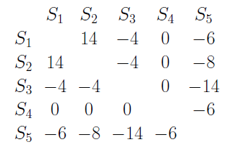
Star Alignment
Assume these pairwise alignment scores are given in the following matrix

Slide 14
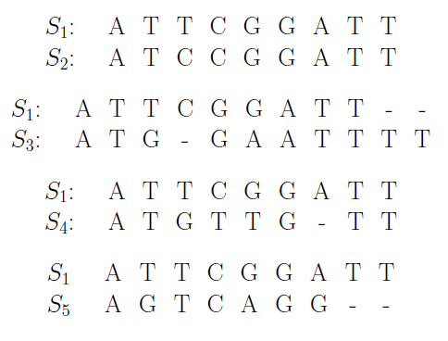
Star Alignment
Summing pairwise scores in each row in the matrix, we obtain that S1 is closest to all the other sequences. Hence, S1 is selected to be at the ‘center’ of the star.
1. Calculating the optimal pairwise alignments between S1 and all other sequences. Assume they are

Slide 15
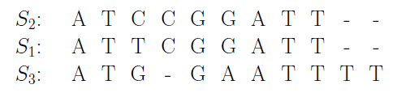
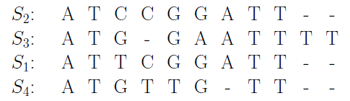
Star Alignment
2. Merging all the alignments using “once a gap, always a gap” principle.
Finally, we add S4 and S5 in order.

Slide 16
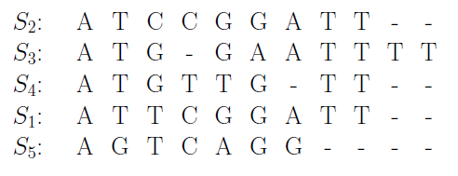
Star Alignment

Slide 17
Complexity Analysis
Given k sequences of length n, the star alignment approach takes O(k2n2) time to calculate all the pairwise alignment scores and then find the sequence S that is at the ‘center’ of the star. It then takes O(k · l) time for merging all the pairwise alignments to form a multiple alignment, where l is the length of the resulting alignment.

Slide 18
CLUSTAL W
Works by progressive alignment.
Clustal W was introduced by Julie D. Thompson and Toby Gibson of EMBL, EBI.
Most closely related sequences are aligned first, and then additional sequences and groups of sequences are added, guided by the initial alignments .
Uses alignment scores to produce a phylogenetic tree.

Slide 19
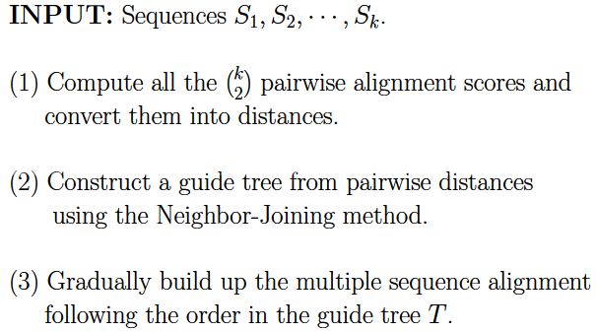
CLUSTAL W
Algorithm:

Slide 21
Clustal W suffers the following problem
Optimal alignment may not be found.
The guide tree is derived from pairwise distances and less reliable.
When all the sequences are highly divergent (say less than 25-30% identity between any pair of sequences), this progressive approach becomes less reliable.

Slide 22
Neighbor-Joining method
Starting point: Distance matrix
Clustering the two nearest nodes:
Tree: Connect pair of nodes to common ancestral nodes, compute branch lengths from ancestral node to both descendants
Distance matrix: Replace the two join nodes with the new (ancestral) node. Compute new distance matrix, by finding distance from new node to all other nodes
Repeat until all nodes are inked in tree
Results in only one tree there is no measure of tree-goodness

Slide 23
Neighbor-Joining Algorithm
For each tip compute u_{i} =∑_{j} D_{ij}/(n-2)
(essentially the average distance to all other distance to all other tips, except the denominator is n-2 instead of n-1)
Find the pair of tips, I and j, where D_{ij}-u_{i}-u_{j} is smallest
Connect the tips i and j, forming a new ancestral node. The branch length from the ancestral node to i and j are:
V_{i} = .5 D_{ij} + .5 (u_{i}-u_{j})
V_{j} = .5 D_{ij} + .5 (u_{j}-u_{i})

Slide 24
Neighbor-Joining Algorithm
Update the distance matrix: Compute distance between new node and each remaining tip as follows:
D_{ij,k} = (D_{ik} + D_{jk} – D_{ij})/2
Repeat tips i and j by the new node which is now treated as a tip
Repeat until only two nodes remain.

Slide 25
Example
 | A | B | C | D
A | 0 | 17 | 21 | 27
B | 17 | 0 | 12 | 18
C | 21 | 12 | 0 | 14
D | 27 | 18 | 14 | 0
u_{i}
32.5
23.5
23.5
29.5
D =
 | A | B | C | D
A |  | -39 | -35 | -35
B |  |  | -35 | -35
C |  |  |  | -39
D
D* =
D_{ij} - u_{i} - u_{j}

Slide 26
…
Now calculate the v_{i} and v_{j} , i.e.
V_{i} = .5 D_{ij} + .5 (u_{i}-u_{j})
V_{j} = .5 D_{ij} + .5 (u_{j}-u_{i})
V_{C} = .5 * 14 + .5 (23.5 – 29.5) =4
V_{D} = .5 * 14 + .5 (29.5 – 23.5) = 10
C
D
4
10
X

Slide 27
…
 | A | B | X
A |  | 17 | 17
B |  |  | 8
X
u_{I}
34
25
25
D =
 | A | B | X
A |  | -42 | -28
B |  |  | -28
X
C
D
A
B
D* =
4
10
13
4
X
Y
V_{A} = .5 * 17 + .5 (34 – 25) =13
V_{B} = .5 * 17 + .5 (25 – 34) = 4

Slide 28
…
 | X | Y
X |  | 4
Y
D_{YX} = (D_{AX} + D_{BX} – D_{AB} )/2
C
D
A
B
4
10
13
4
X
Y
4

Slide 29
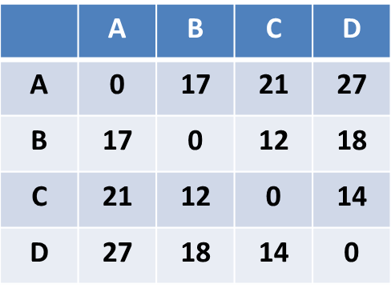
Finally,
C
B
4
4
4
10
13
D
A

Slide 30
references
LipmanDJ, AltschulSF, KececiogluJD (1989). "A tool for multiple sequence alignment“.
Scott Walmsley, PhD, Research Instructor, Department Pharmaceutical Sciences, Skaggs School of Pharmacy
Phylogenetic analysis by Neighbor Joining Method, BioPandit presents
http://www.bii.astar.edu.sg/docs/education/lsm5192_04/Multiple%20Sequence%20Alignment%20Progressive%20Approaches.pdf
Lecture 18_ Multiple sequence alignment I, UC Davis Academics

Slide 31


